Slide 1
Treating Speech Intelligibility in Patients with Parkinson’s Disease

Slide 2
Treatment s for Parkinson’s
Medication
Surgery
Speech and Language
Many facets to consider when treating someone with Parkinson’s disease
Team approach with the patient, caregiver and various professionals
SpeechEasyPD helps with just one piece of the treatment plan – speech intelligibility

Slide 3
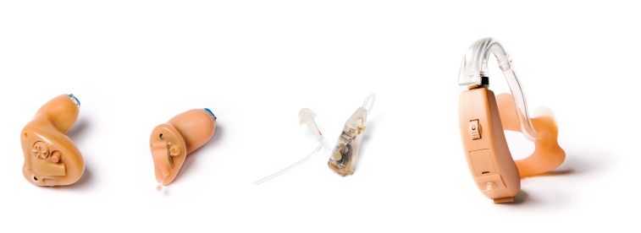
What is SpeechEasyPD?
Small device that looks similar to a hearing aid
Uses a delay and change in pitch to create the choral speech effect
Worn in one ear
Individually fit and customized for each specific person
Made by Janus Development Group, Inc.

Slide 4
How We Came to Be
SpeechEasy was developed at East Carolina University to help treat those who stutter
We have over 110 locations where SLPs have been using this technology for 12+years
Research was conducted using SpeechEasy with those with Parkinson’s
Saw that SpeechEasy could be beneficial
Entered a new license agreement with ECU for SpeechEasyPD

Slide 5
How Does it Work?
Uses a delay and change in pitch to emulate choral speech
Choral speech is just people saying the same thing at the same time
Patients with palilalia have a type of repetitive speech that is decreased when using the effects of choral speech
The delay being used will also naturally slow the patient’s rate of speech
Slowed rate can lead to increased intelligibility, better articulation, increased self monitoring

Slide 6
Treatment Goals
Helps in overall communication
Increase fluency and intelligibility
Decrease rate
Decrease palilalia
Decrease effort demands from patient
Increase volume
Increase intelligibility
Improve self-monitoring

Slide 7
How Do I Get It?
To obtain SpeechEasyPD, patients are first evaluated by a Speech Pathologist specifically trained to use this type of technology – A SpeechEasyPD Provider
Evaluations take about 2 hours
Patients work with a device and the SpeechEasyPD Provider to help find the settings that are most appropriate
Techniques that pair well with the device are reviewed and taught as well

Slide 8
How Do I Get It?
Since every patient is different and everyone has a different response to the device, an evaluation is the only way to know how the effects will benefit any given person
There is no obligation to purchase a device at any time
The patient and their caregiver will decide if SpeechEasyPD is the right treatment choice or not

Slide 9
Pick Up Appointment
If a patient chooses to purchase a device, they return to the SpeechEasyPD Provider to pick it up
At this time, they review the care and maintenance of the device and create a treatment plan
Patients are referred back to their treating SLP, but are able to return to the SpeechEasyPD Provider for any device adjustments or additional therapy sessions

Slide 10
SpeechEasyPD
Each device comes with a workbook
Reviews care and maintenance
Gives therapy guidance and tips and hints
Used to supplement the direct treatment provided by the team of professionals
As the patient’s needs change, their settings may also need to change
Patients can go back to the SpeechEasyPD Provider for these adjustments or send their device to Janus

Slide 11
Trial Period
Each device comes with a 60-day trial period. From the day a patient receives their device, they have 60 days to try it in their daily life to help ensure it works for them when they need it most.
If for whatever reason, they decide within the first 60 days that SpeechEasy is not for them, they may return the undamaged device to Janus Development Group for a refund, less 10% of the MSRP.

Slide 12
Common Questions
Frequency of use
Hearing aids
Maintenance
Provider locations

Slide 13
Funding
Payment options include:
Personal check or Cashier’s check
Credit cards
Flexible spending plan through employers
Veteran’s Administration
Lease-to-Own Program
0% Financing Program

Slide 14
Questions?
Amber Snyder, MS, CCC-SLP
amber@speecheasy.com
252-864-4443
Janus Development Group
866-551-9042
info@speecheasy.com

