Slide 1
The Therapy of Rhythm: Using Movement in the Management of Parkinson’s Disease
Presented By: Tess Dalleave, OTAS

Slide 2
Benefits of regular physical activity:
Reduces mental stress
Relieves depression and anxiety
Improves strength and endurance
Helps to prevents falls and injuries
Increases blood flow to brain
Creates new neuron (nerve cell) branches
Stimulates dopamine production
Reduces symptoms
Slows progression of PD if started early
Improve function in daily activities
The effectiveness of exercise interventions for people with Parkinson's disease: A systematic review and meta‐analysis. Movement Disorders, 23(5), 631-640.

Slide 3
Common obstacles to healthy habits:
Takes time
Can cost $$$ (gym memberships, equipment)
Takes planning and effort
Fear of falls
Boring
No motivation

Slide 4
What types of exercise are good for those living with PD?
Big, gross motor movements
Slow, controlled movements
Repetitive exercises
Low risk of falls
Incorporates visual and/or auditory cues

Slide 5
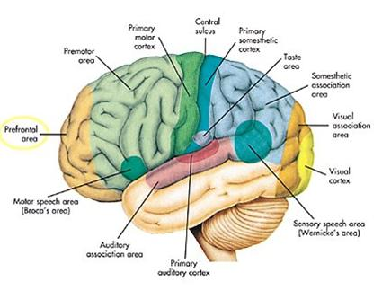
Cueing and Parkinson’s Disease
Auditory Cues-
Instructions or prompts
that can be heard
Visual Cues-
Instructions or prompts
that can be seen
Nieuwboer, A., Kwakkel, G., Rochester,
Cueing training in the home improves gait-related mobility in Parkinson’s disease: the RESCUE trial
Journal of Neurology, Neurosurgery & Psychiatry, 78(2), 134-140.

Slide 6
Martial Arts/Yoga/Tai Chi
Uses large, slow and controlled movements
Greatly improves balance and posture
Incorporates visual and auditory cues (when in a group class)
Promotes relaxation and eases symptoms of depression
Local Resources:
Joyful Movement with PD- Central Orange Senior Center on Mondays from 2:00-2:50pm. $6 per class
NIA (Neuromuscular Integrative Action)- Central Orange Senior Center and the Robert and Pearl Seymour Center. $6 per class
Tai Chi for Beginners- Central Orange Senior Center or the Robert and Pearl Seymour Center
http://www.youtube.com/watch?v=TiYFxzh0ol4

Slide 7
Dance Movement Therapy
Increases self-awareness, self-esteem and independence
Improves communication
Enhances social interaction skills.
Decreases bradykinesia (extremely slow movement), tremors and freezing
Improves gait, balance and posture
Fun!
Local Resources:
Neurosavvy - Seymour Center - $25 for 6 week classes
http://www.youtube.com/watch?v=TqMhhHj8ILU
Tango improves balance, mobility in patients with Parkinson's disease - The study was published in the Journal of Neurologic Physical Therapy.

Slide 8
LSVT BIG (Lee Silverman Voice Treatment BIG)
Improves balance, gait, transfers
Increases size of movements
Program requires 16 intensive, one-hour session visits over the course of a single month
Sessions are lead by a LSVT trained and certified Physical Therapist or Occupational Therapist
http://www.lsvtglobal.com/patient-resources/what-is-lsvt-big

Slide 9
MeMoves
DVD upper body exercise program
Can be used at home alone, or with a group
Low risk of falls
Easy to follow visual and auditory cues
http://memovesstore.com/ $69.95 “Life Moves”

Slide 10
Review
1. What are some physical activities that can be done without risk of falls?
2. Which types of exercises are best for Parkinson’s disease?
A- Intense aerobic exercises to build cardio endurance.
B- Large, controlled movements that are simple.
C- “Sweatin to the Oldies” with Richard Simmons
D- Heavy weight lifting to build muscle.
3. Name 1 benefit of regular physical activity.

