Slide 1
Care Partners: Caring for You, Caring for Me
Lisa P.Gwyther, MSW, LCSW
Duke Family Support Program
UNC Parkinson’s Disease Support Group
Seymour Senior Center, Chapel Hill, NC
April 5, 2011
lpg@geri.duke.edu
www.dukefamilysupport.org

Slide 2
Are You A Care Partner?
Organizing daily and adapting work
Finding, asking for and using help
Solving problems
Making, carrying out and living with the consequences of decisions
Dealing with imbalances in give-and-take
Dealing with resentment, disappointed expectations and uncertainty
Gwyther

Slide 3
Are you a Care Partner?
Recognizing there is never enough of you or enough of the quality help you need
Always second guessing
“When was the last time you didn’t worry about…?”
“Do you know more about his prescriptions than your own?”
“Do you feel anxious when the phone rings?”
Gwyther

Slide 4
Care Partner Quotes
Oh my gosh, I won’t ever be able to handle this.
What if she needs me in the middle of the night, and I can’t hear her?
Oh, he’ll be fine when the meds get straightened out.
We can’t have one more thing go wrong!
What’s the use – nothing changes.

Slide 5
The Seesaw
“During the good times, we tried to talk ourselves into believing that it wasn’t really as serious as we had expected, but the seesaw was exhausting and so very sad.”

Slide 6
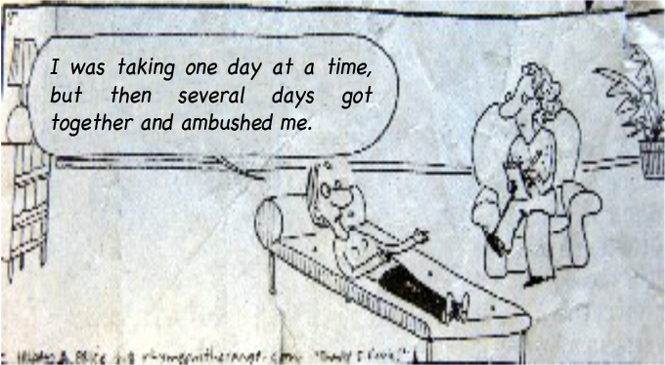
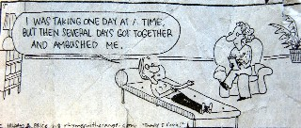
Notes:
6

Slide 7
Care Partner Quotes
It’s changing the melody
We must find a new normal
It helps to release your cover
It’s about coping with stigma and fear

Slide 8
What Care Partners say:
She never would have wanted that before.
I still care about our relationship – I don’t want to fight like this.
He seems unaware of how his behavior affects us.
Why is she so nice to strangers and so mean to us?
They’re Your Parents Too

Slide 9
Family Care
Care partners become by caring about
Care partners do the best they can because they can’t imagine doing otherwise
Family care happens: it’s just a question of when and for how many
Family care affects all relationships
Family care is rarely fair, equal
Family care disrupts people’s lives

Slide 10
The 6 Cs of Family Care
Common
Chronic
Complex
Costly
Choices
Conflict

Slide 11
What Do Care Partners Do?
Define and negotiate complex situations
Perform physically intimate tasks
Manage emotions and communication
Modify expectations - pace for a marathon, not a sprint
Capitalize on preserved capacities

Slide 12
The Family Care Balancing Act
Whose needs? (the myth of the well care partner)
How long?
How much?
How to evaluate risk, cost and benefit?

Slide 13

If Only …
the
FORTUNE
Teller
Gwyther 07
Notes:
13
13

Slide 14
Decision-making Hazards
Unrelenting crises
Old promises
Chasing ghosts
Conflicting perceptions, expectations
Control issues
Too few good choices

Slide 15

Someone Has To Be “It”
Gwyther
Notes:
15

Slide 16

Not-So-Well-Blended Families
Gwyther
Notes:
16
16
16

Slide 17

Here Comes The Judge!
Gwyther
Notes:
17

Slide 18

The Fixer
Gwyther
Notes:
18

Slide 19
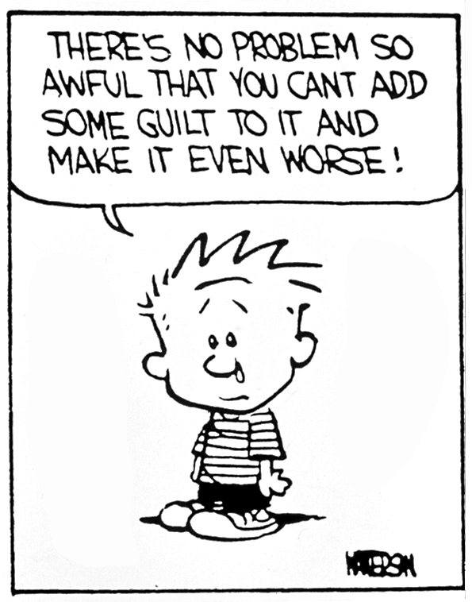
Notes:
19

Slide 20
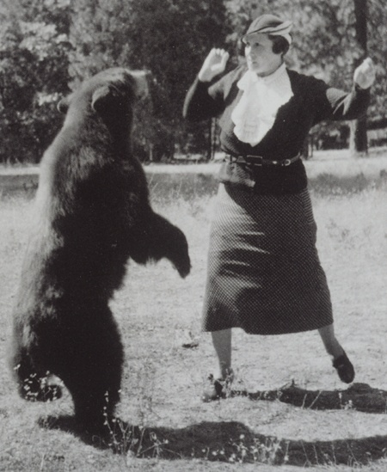
There are no Perfect Solutions no Saints, no Superwomen…
Notes:
20

Slide 21
The Voice of Experience
“Her disease is beyond even a pretense of my control. I realized I was strong enough, kind enough, loving enough and patient enough to endure the unspeakable, but I could also cut myself some slack when I wasn’t perfect.”
TJ Barron, 2007

Slide 22
Care Partners: Beware
You will be angry with:
  Family and friends
  Doctors who offer little
  Careless motorists
  Slow checkout clerks
Notes:
22

Slide 23
Feeling Cheated
“I bop between feeling angry & feeling guilty for feeling angry. Everyone takes care of him, but what about me?”
Wife care partner
Notes:
23

Slide 24
Anger Warning Signs:
You are “taking it out” on your family or yourself.
You do everything, but it is never enough.
You are losing it more often with your care partner
You resent everything and it’s all too much.
You have fantasies about disappearing, running away or telling her to “just go if you want to…”
Notes:
24

Slide 25
What about Family Members Missing in Action?
You can’t create empathy and compassion – don’t waste emotional capital
Frame behavior of the invisible ones in a way that explains it, so you can put it aside and avoid future disappointment

Slide 26
Acceptance
Acceptance is simply seeing something the way it is and saying,
“That’s the way it is.”
Notes:
26

Slide 27
Acceptance is NOT:
Approval
Consent
Sanction
Agreement
Compliance
Sympathy
Endorsement
Confirmation
Encouragement
Promoting
Or EVEN LIKING
Notes:
27

Slide 28
Helpful Talk
I Apologize
I Am Sorry You Are Upset.
I Know This Is Hard
I Wish Things Were Easier For Us.
I Will Stay Until You Feel Better

Slide 29
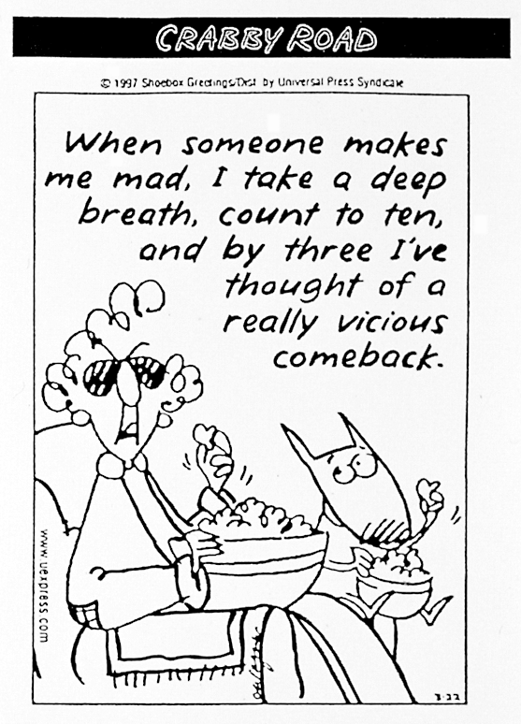
Notes:
29

Slide 30
Circuit Breakers
Humor helps
“Good enough for now”
Meditation, tai chi, prayer
Mindfulness
Jump off the Fast Track
Notes:
30

Slide 31
Re-framing Helps
No lines at the Super Wal-Mart
We can still get in bed and listen to the rain on the sky light
Finding what I want on sale always helps
He still plays with my hair and tells me I’m beautiful
Sometimes, hot towels after a bubble bath work wonders
The puppy reminds us to hold hands, head for playground and swing on the swings

Slide 32
I AM WORTH IT
Important: To me?
Appropriate: Do negative feelings fit facts of situation?
Modifiable: In a positive way?
Worth it: When I balance needs of
myself and others, is taking action worth it?
Williams LifeSkills
Notes:
32

Slide 33
Action and Deflection Skills
Action skills:
Problem solving, assertion,
saying “no”
Deflection skills:
Reason with self, thought
stopping, distraction, relaxation,
meditation
Notes:
33

Slide 34
Pleasant Events:
Approach to Depression and Anger
Nature
Social
Thoughts and Feelings
Recognition from others
Giving to others
Competence
Leisure
Spiritual

Slide 35
Care Partner Reminders
Work toward a more equitable, not equal, sharing of responsibility.
You will be forced to choose between equally unacceptable options.
Subjective perceptions trump objective reality
Creativity and practical problem-solving skills help.

Slide 36
Care Partner Reminders
There is no perfect control – work on reactions to stress or lack of control
A primary care partner is efficient and preferred, but these people need breaks, backup people and services to supplement their personalized unscheduled help.
Even in ideal situations, contingency plans are necessary.

Slide 37
Ten Reminders for Care Partners
1.The desire not to think about what you are facing is normal, but you can get beyond it.
2. The process of the disease is not completely predictable. Other things happen. Your care partner will need different help over time. You may be forced to make decisions neither of you will like.
3. Care partners need to help, give, find meaning, purpose and leave a legacy

Slide 38
Ten Reminders (cont.)
4.The person with PD is probably doing the best he/she can. Trying harder can be frustrating.
5. Both of you will have to change.
6. Your emotional relationship with each other will change despite your continued love and willingness to help.

Slide 39
Ten Reminders (cont.)
7. Grief comes with this process of loss. It is hard to see suffering.
8. There is no single right or wrong place to care or care plan.
9. This is the rainy day for which you saved.
10. Care partners need respite from each other

Slide 40
Resistance to Community Service Referrals
Stigma
Denial/ poor judgment
Too many changes at once
Loss of control
Cost
Overwhelming disclosure in assessment – privacy issues

Slide 41

Eskimos eat whales and tiny termites eat mighty houses the same way – one bite at a time
Jerry Wilson

Slide 42
How do we evaluate “help?”
Dependable
Sufficient
Quality
Dignified
Accessible
Flexible
Consumer-directed
Person and family-centered

Slide 43
Messages for Care Partners
Be willing to listen but understand you cannot fix or do everything he or she may want or need.
Things will change but they will not necessarily get easier
Decide what you can and will do, set limits and call in reinforcements
Doubts are inevitable

Slide 44
Messages for Care Partners
The person with PD is not unhappy or upset because of what you have done. He is living with unwanted limits.
People with chronic illness often take out their frustration on close family.
Considering what is best for the family involves compromise among competing needs, loyalties and commitments. Everyone may get some of what s/he wants
Think twice before giving up that job, club or church group.

Slide 45
Messages for Care Partners
Find someone with whom you can be brutally honest, express those doubts and negative feelings and move on.
Solving problems is much easier than living with the solutions.
Avoid promises that include the words always, never or forever
Take time to celebrate small victories when things go well.

Slide 46
Successful Care Partners
Religious faith, participation, belief system
Re-frame or change perspective
Reduce Type A behavior
Seek dependable sufficient support
Respite or sabbatical options
Energy economies
Forgiveness opportunities
Expressive/ altruistic outlets
Notes:
46

Slide 47
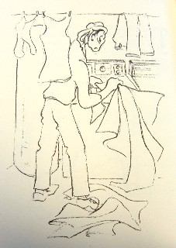
Expect the Unexpected
”Why isn’t this more like Tuesdays with Morrie?”
Notes:
47

Slide 48
Advanced Directives
Surrogate decision making on a psychological par with having your house burn down (Sulmasy, 2011)
Living wills don’t neatly address specific medical situations
People change their minds
Know care partner’s values intimately, ask questions and be an advocate

Slide 49
Good Advice
Hope for the best
Plan for the worst
Life is a play
We’re un-rehearsed
Mel Brooks

